Slide 1
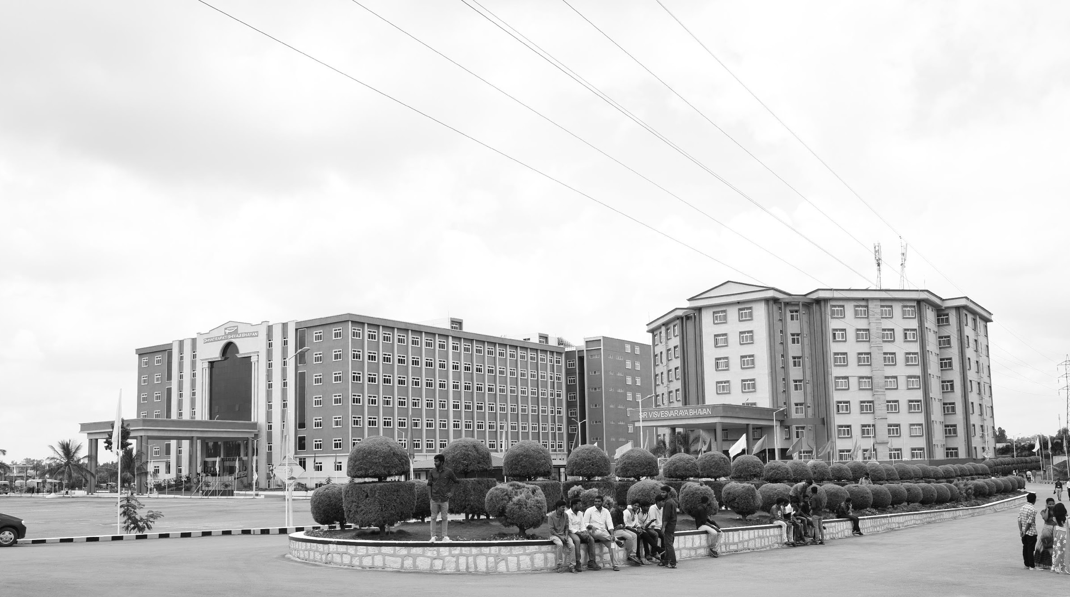

REDESINING TPMS AND BCM FOR ZONAL ARCHITECTURE
Mid-Review 3
Major Project
Project ID: CS12
AY 2021-25
GITAM (Deemed-to-be) University
Department of Electrical Electronics and Communication Engineering
Project Team:
SHAIK RAHIL – BU21EECE0100538
SHAROOKH N MURADI – BU21EECE0100517
Project Mentor:
DR. SUBHASHISH TIWARI
Project In-charge:
DR. ARUN KUMAR
www.gitam.edu

Slide 2
Objective and Goals
Objective
Redesign the Tire Pressure Monitoring System (TPMS), Heating, Ventilation, and Air Conditioning (HVAC) system, and Body Control Module (BCM) to adapt to a zonal architecture in modern vehicles.
Create an optimized, modular system architecture to enhance system efficiency, responsiveness, and integration.
Improve vehicle performance while reducing complexity and enabling advanced functionalities like real-time monitoring, zonal temperature control, and enhanced safety.
Ensure scalability and future-readiness for next-generation automotive technologies.
Goals
Main Goals
Redesign the Tire Pressure Monitoring System (TPMS), HVAC system, and Body Control Module (BCM) for zonal architecture.
Develop a modular and optimized system architecture to enhance system efficiency and responsiveness.
Improve integration between various vehicle subsystems.
Enhance overall vehicle performance while reducing system complexity.
Ensure scalability to support future automotive advancements.
Additional Goals
Enable advanced functionalities like real-time monitoring.
Introduce zonal temperature control for improved passenger comfort.
Implement enhanced safety features to meet modern standards.

Slide 3
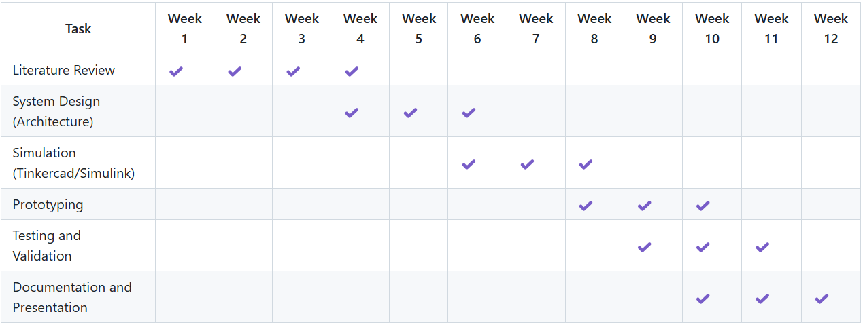
Project Plan (Clearly mention milestone for objectives under each reviews)

Slide 4
Project Review 1 Summary
1. Literature Survey
Researched existing TPMS and BCM systems.
Analyzed the need for zonal architecture in modern vehicle networks.
Identified key challenges and advancements in automotive systems.
2. System Architecture
Designed using Tinkercad for initial prototyping and validation.
Implemented TPMS sensors to monitor tire pressure and temperature.
Integrated BCM components for controlling lighting, door locks, and climate systems.
Established communication links between sensors, microcontrollers, and actuators.
Tinkercad Circuit Design
Developed a functional prototype using virtual components.
Microcontroller Used: Simulated with Arduino for real-time processing.
Components Integrated:
TPMS Sensors – Pressure & temperature monitoring.
LED Indicators – Alert for low pressure conditions.
BCM Modules – Control for lighting, door locks, and climate.
Display Interface – Shows real-time sensor values.
Tested sensor-to-microcontroller communication and actuator response.
Verified system behaviour in various simulated conditions.

Slide 5
3. Use Cases
Use Case 1: Tire Pressure Monitoring System (TPMS)
Actors: TPMS Sensors, Microcontroller, Alert System, Driver. Description:
The system continuously monitors tire pressure in real time.
If pressure drops below a threshold, an alert is triggered.
The driver receives a visual (LED) and/or audible warning.
Data can be logged and transmitted to a central ECU for further analysis.
Workflow:
Sensors detect real-time tire pressure and temperature.
Data is sent to the microcontroller for processing.
If pressure < 30 PSI → Warning LED blinks + buzzer activates.
Driver takes action to inflate the tire or seek maintenance.
Benefits:
Enhances safety by preventing blowouts.
Improves fuel efficiency by maintaining optimal tire pressure.
Extends tire lifespan and reduces wear & tear.
Use Cases for BCM – Wiper System
Use Case 1: Automatic Rain-Sensing Wiper Activatio
Actors: Rain Sensor, Body Control Module (BCM), Wiper Motor, Driver. Description:
The rain sensor detects water droplets on the windshield.
The BCM processes the signal and determines the wiper speed.
The wiper motor is activated automatically without manual input.
The driver does not need to switch on wipers manually during rainfall.
Workflow:
Rain sensor detects moisture on the windshield.
Sensor sends a signal to the BCM.
BCM analyzes rain intensity and determines the wiper speed:
Light rain → Slow wiping speed
Heavy rain → Fast wiping speed
BCM activates the wiper motor accordingly.
If no rain is detected for a while, BCM stops the wipers.
Benefits:
Hands-free operation improves driver convenience. Improves visibility during rain without distractions. Optimized wiper speed reduces unnecessary wear & tear.

Slide 6
4. Testing & Implementation
Implementation Using Tinkercad
We designed and simulated our TPMS & BCM circuit using Tinkercad to test system functionality before hardware implementation. The prototype was developed using virtual components to validate sensor data processing, alerts, and automation.
Components Used in Tinkercad Simulation: Microcontroller: Arduino (for TPMS & BCM control) TPMS Sensors: Simulated pressure and temperature sensors LED Indicators: Alerts for low pressure and system warnings Buzzer: Audible warning for tire pressure issues Display (LCD/Serial Monitor): Real-time tire pressure readings

Slide 7
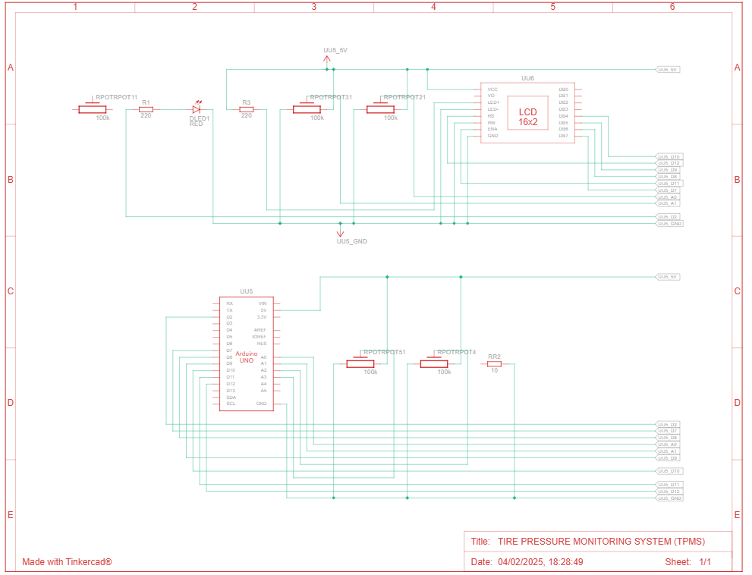
Architecture
Structural Diagram
Block Diagram/Pin Diagram
Tire Pressure Monitoring System (TPMS) Using Arduino

Slide 8
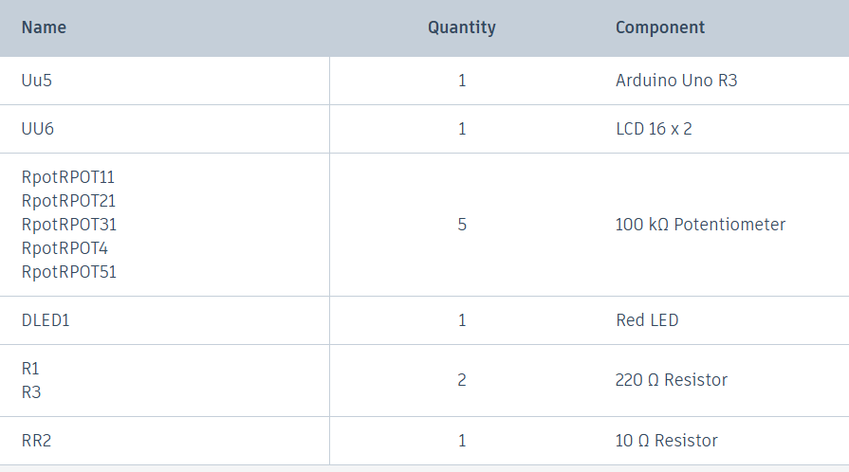
Components Used

Slide 9
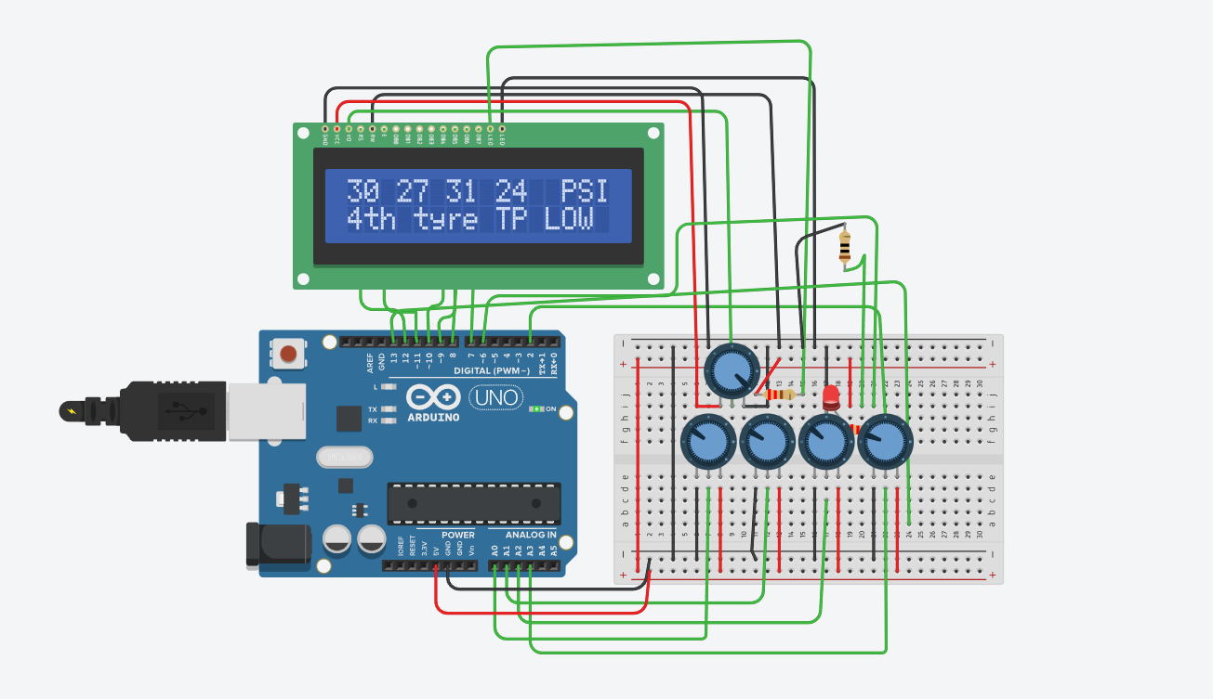
Implementation and Results
Results For TPMS (Tire Pressure Monitoring System):

Slide 10
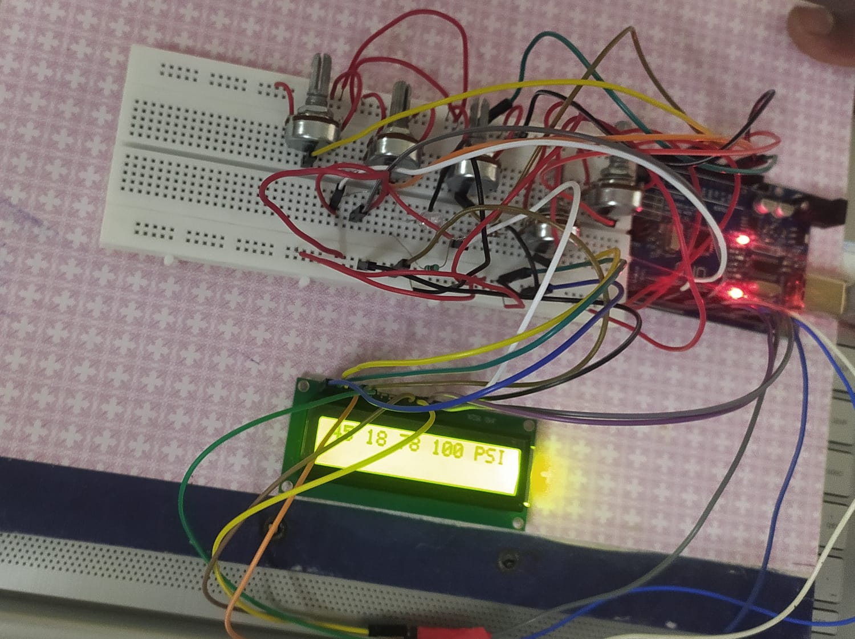
Working Hardware Model – TPMS(Tire Pressure Monitoring System)

Slide 11
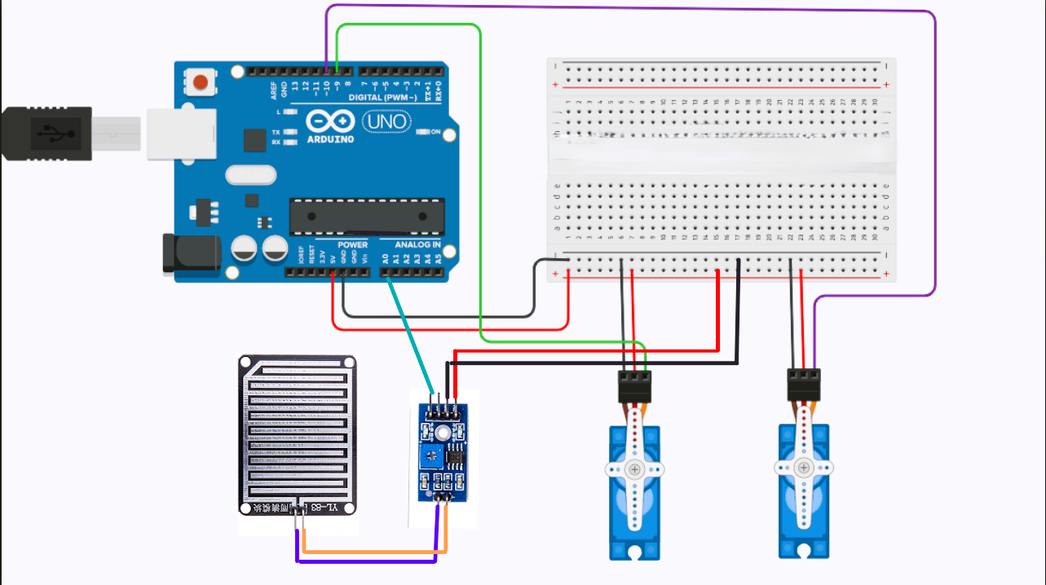
Implementation and Results
Results For BCM (Body Control Module) – Wiper System
Components Used
Rain Drop Sensor
Arduino Uno
Servo Motor MG996R
Jumper wires

Slide 12
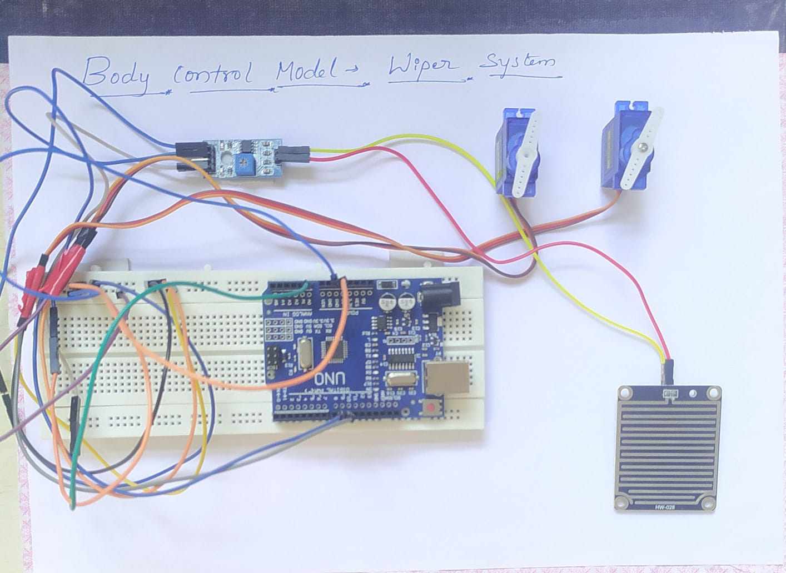
Working Hardware Model – BCM – Wiper System

Slide 13
THANK YOU
Have a Great Day !

